Slide 1
Mwamba Ally Jingu: FCPA; PhD
Basic Operations of a Computer-Fundamentals
Mwamba Ally JIngu: FCPA; PhD

Slide 2
What is a Computer?
A computer is a data processing machine and it needs user’s instructions to perform any job.
After processing the raw facts (called data), it produces useful information for the user.
But how do you give data and instructions to the computer and how it can return the useful information to you.
To do all these, different types of input and output devices can be connected with the compute
Mwamba Ally JIngu: FCPA; PhD

Slide 3
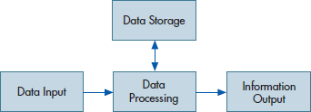
Mwamba Ally JIngu: FCPA; PhD

Slide 4
Input Unit
Inputting is a basic operation of a computer system. This is the act of feeding in the data and instruction to the computer (by computer here it means the processing unit).
Information and programs are entered into the computer through Input devices such as the keyboard, disks, or through other computers via network connections or modems connected to the Internet.
The devices that helps you to input data and instructions into the computer include: Keyboard, Mouse, Light Pen, JoyStick, Scanners, Microphone
Mwamba Ally JIngu: FCPA; PhD

Slide 5
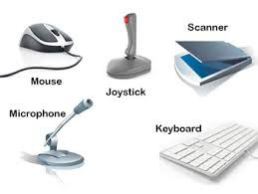
Mwamba Ally JIngu: FCPA; PhD

Slide 6
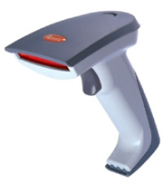
Input Device Continued
The devices that can send data directly to the CPU or which does not need to encode it before sending to CPU are considered as Direct Entry Input Devices. Examples includes scanners.
Devices such as keyboard which require to encode data so that it is in the form a CPU can understand are Indirect Entry Input Devices.
Bar Code Reader: It is used for reading bar coded data (data in form of light and dark lines). Bar Code Reader scans a bar code image, converts it into an alphanumeric value
Mwamba Ally JIngu: FCPA; PhD

Slide 7
Storing Device
Before actual processing start, data & instructions entered to the computer must be stored somewhere inside the computer.
Similarly, results produced by the computer are required to be stored before it is passed to the output unit. The intermediate result produced by the computer must also be stored for further processing.
Based on whether storage device is inside the main machine or not, it can be internal or external storage. Similarly, looking at whether the storage device works close with CPU or works as backup media, they can be primary storage or secondary storage. Primary storage is also called primary memory. Secondary storage is known with other names such as backup storage or secondary memory.
For the storage purpose, a computer system may have different devices such as registers, RAM/ROM, flash, magnetic disks, optical disks etc.
Mwamba Ally JIngu: FCPA; PhD

Slide 8
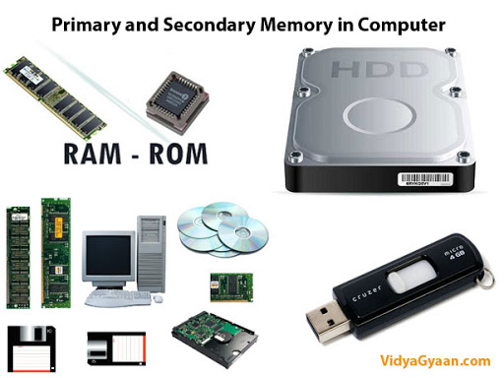
Mwamba Ally JIngu: FCPA; PhD

Slide 9
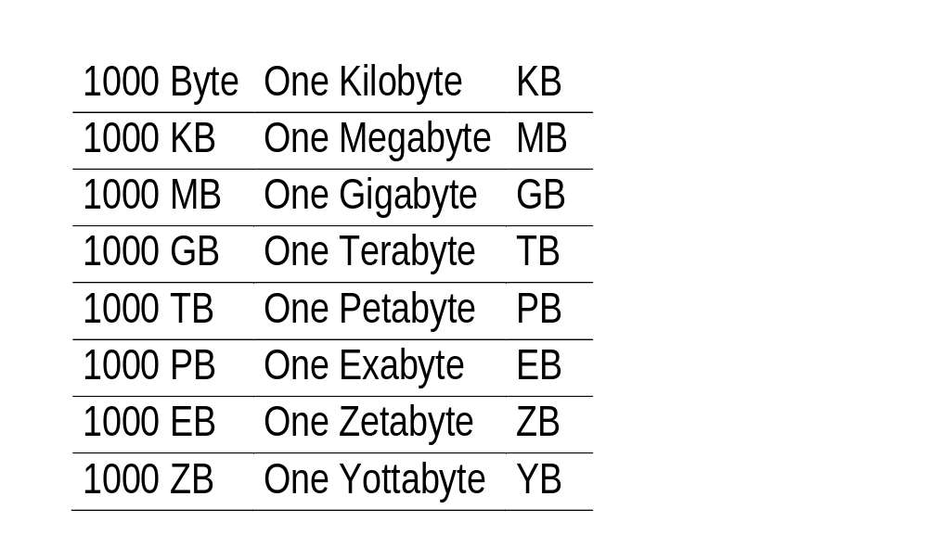
The size of the primary storage is specified in KB (Kilobytes) or MB (Megabyte). One KB =1000 bytes and one MB is equal to 1000KB.
Memory Size in Approximate Values
Note: the above values are Approximates. The actual value of one KB is 1024 bytes, 1024 KB = 1 MB, 1024 MB = 1 GB etc.
Mwamba Ally JIngu: FCPA; PhD

Slide 10
Businesses rely on technology to operate and achieve their goals, and with all technology come risks.
To mitigate the risks every IT system requires controls to be in place to keep the system and data within it secure, maintain continuous operations, and reduce the chance of errors in data processing and transactions.
These types of controls are commonly called general computer controls and general application controls, and ensure IT systems are functioning reliably and as management intended.
Mwamba Ally JIngu: FCPA; PhD

Slide 11
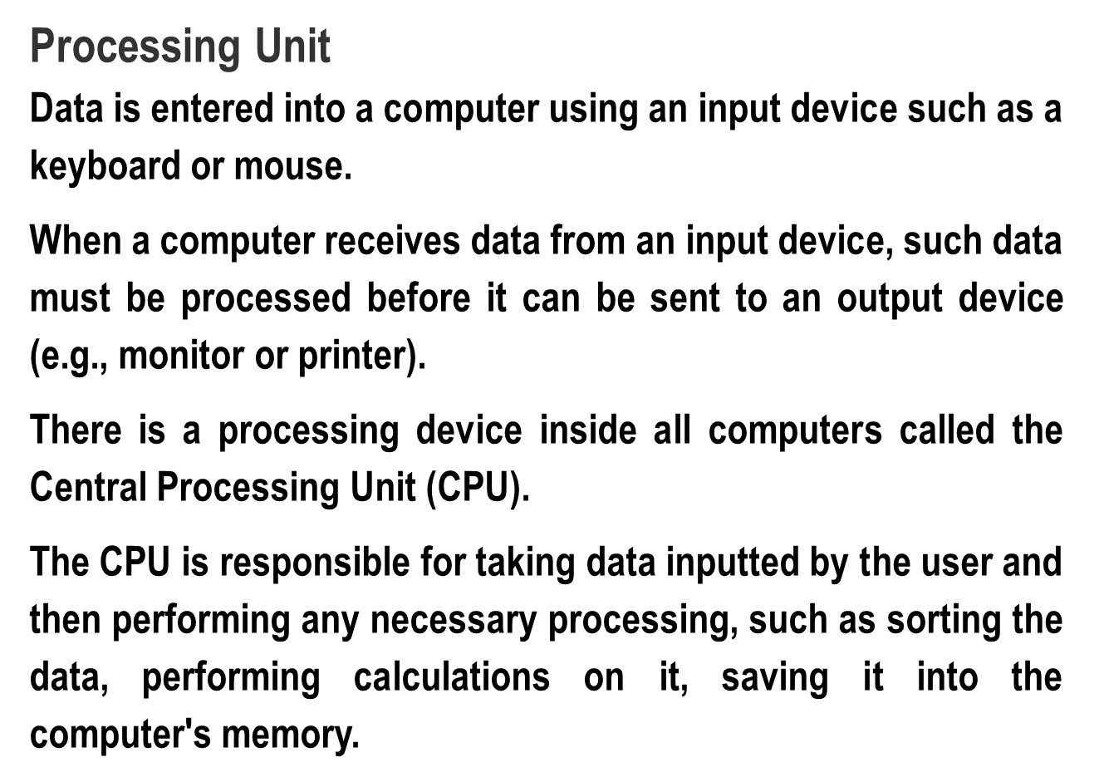
Mwamba Ally JIngu: FCPA; PhD

Slide 12
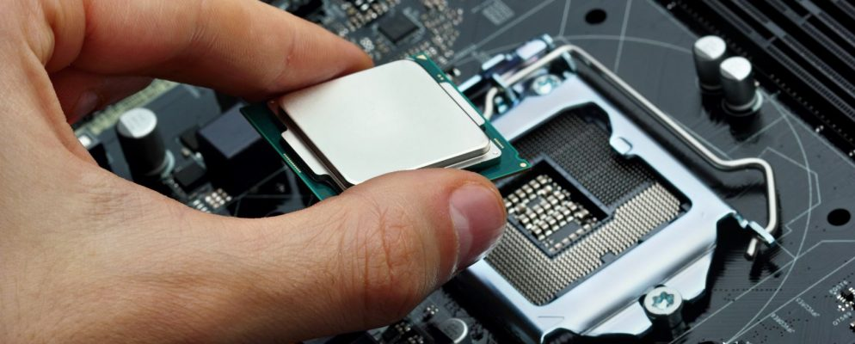
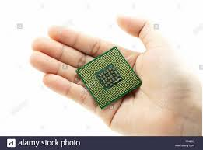
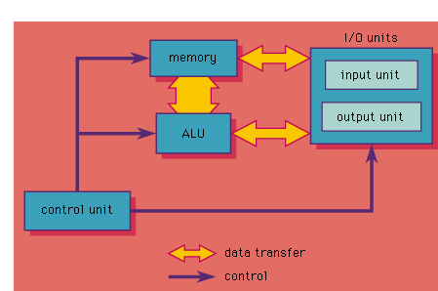
Mwamba Ally JIngu: FCPA; PhD

Slide 13
Processing Device Continued
The data will then be output, perhaps on the monitor, a printer or through any other output device.
The more powerful the processing device is, the more powerful the computer will be. The CPU is usually housed in a computer motherboard.
The motherboard serves as a single platform to connect all of the parts of a computer together.
A motherboard connects CPU, memory, hard drives, optical drives, video card, sound card, and other ports and expansion cards directly or via cables.
Mwamba Ally JIngu: FCPA; PhD

Slide 14
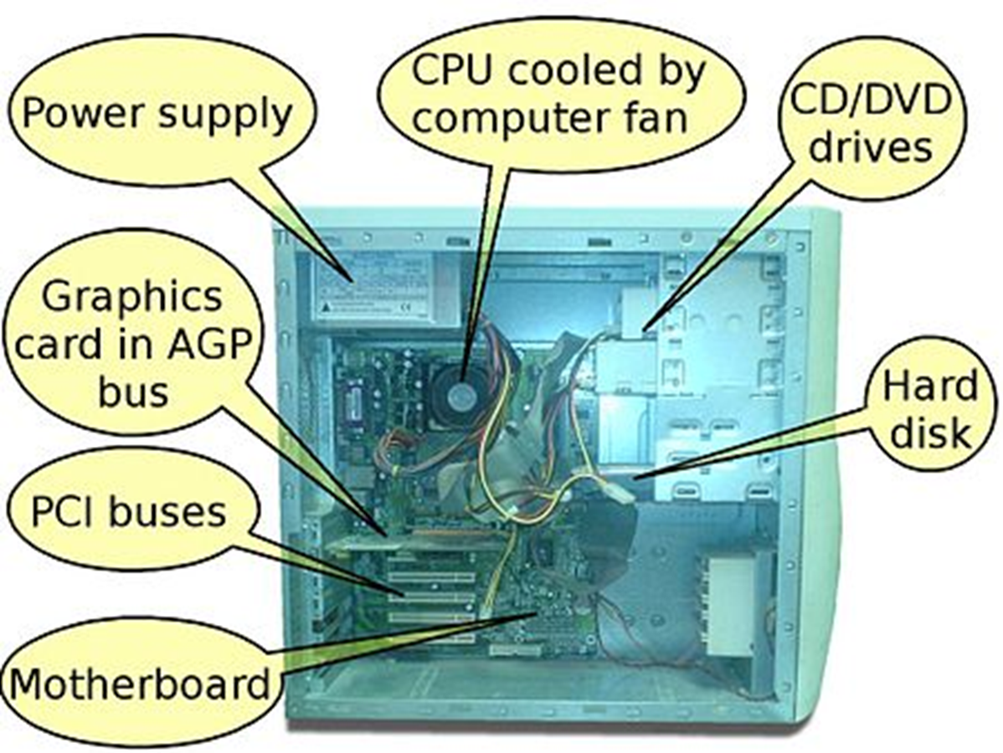
Mwamba Ally JIngu: FCPA; PhD

Slide 15
Output Unit
An output device is any peripheral that receives data from a computer, usually for display, projection, or physical reproduction.
A common example of an output device is a Visual Display Unit (VDU) or, Monitor which displays an image that is received from the computer.
Another common output device is the printer (inkjet and Laser printer). For example, an inkjet printer can make a hard copy of any information shown on your monitor.
Monitors and printers are two of the most common output devices used with a computer. Other types of output devices include projectors, computer speakers, televisions GPS. Video card etc.
It should be kept in mind that drives such as a CD-ROM, DVD and USB Flash drive may be capable of receiving information from the computer, but they are NOT output devices. These are storage devices.
Mwamba Ally JIngu: FCPA; PhD

Slide 16
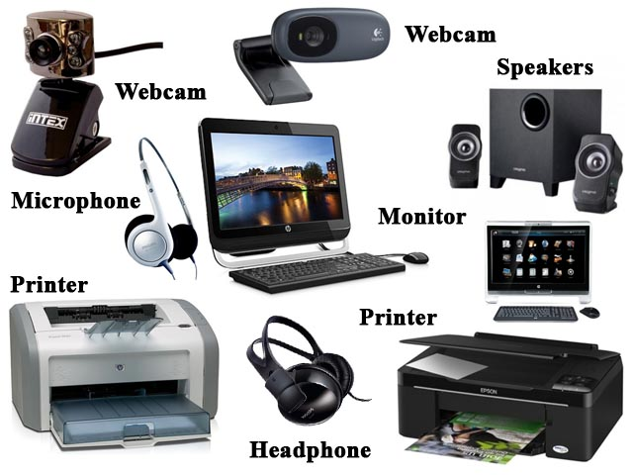
Mwamba Ally JIngu: FCPA; PhD

Slide 17
Types of Application Controls
Application Controls are classified into the following three controls: Input; Processing and Output
Input controls are necessary to ensure that all data entered is authorized, complete, accurate and entered only once. Typically, a combination of manual and automated controls will be required to achieve this
Processing controls will be necessary to ensure that transactions are processed completely, accurately and in a timely fashion.
Output controls will be necessary to ensure the completeness, accuracy and availability of application output, whether it be in a paper form, or as electronic data
Mwamba Ally JIngu: FCPA; PhD

Slide 18
OBJECTIVES OF APPLICATION CONTROLS
The overall objective of an audit review of a computer system is to review system proposals to ascertain whether:
they incorporate adequate internal controls and
ensure that these controls form part of the operational system when implemented and that
any system amendments do not invalidate them.
This overall objective may be broken into four sub-objectives: (1) input control; (2) processing controls;
(3) Output controls and (4) Audit trail.
Mwamba Ally JIngu: FCPA; PhD

Slide 19
Input controls
Audit objectives: Designed to ascertain whether the system does, as far as is reasonably possible, ensure that input is (i) genuine, (ii) complete, (iii) not previously processed, (iv) accurate and (v) timely. (Thus the input controls are either preventive and/or detective in nature)
The auditor needs to satisfy himself or herself on the following:
Authorization of input data: Limit the risk of inappropriate input of key financial data due to unauthorized access to key financial functions or data.
Completeness of input data: All the data has been entered for computer processing
Mwamba Ally JIngu: FCPA; PhD

Slide 20
Input Control Continued
Accuracy of input data: the data have been entered into the computer system accurately.
On-line system: On line input occurs when transactions are entered into the computer as they happen, one at a time; but Batch input occurs when transactions are grouped and entered as a group
Control of input documents: They should be entered into the computer system once.
Mwamba Ally JIngu: FCPA; PhD

Slide 21
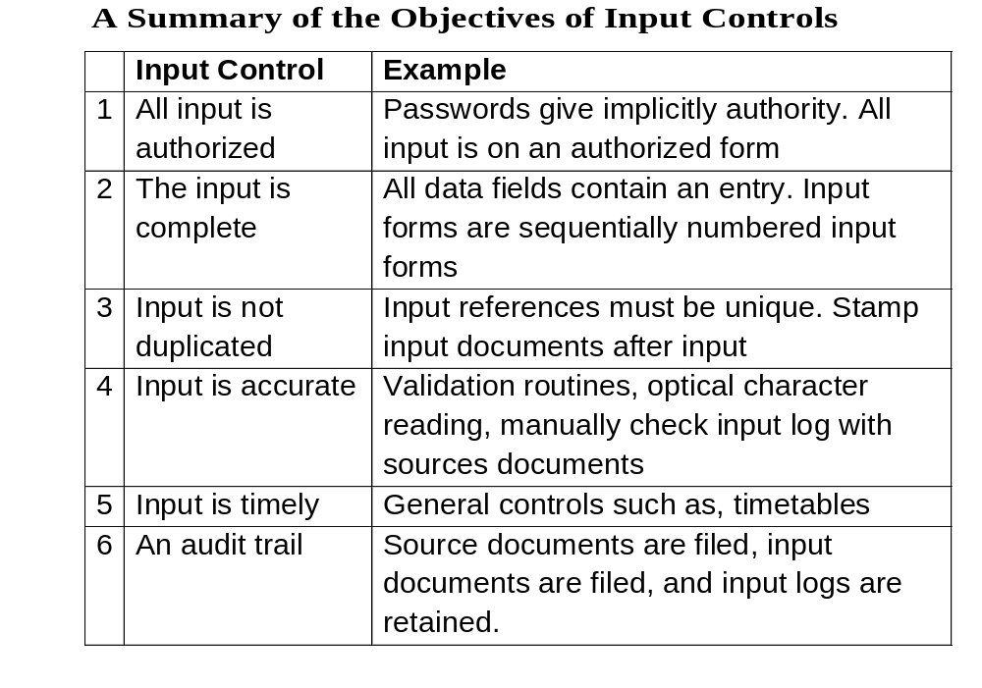
Mwamba Ally JIngu: FCPA; PhD

Slide 22
Key Questions on Input controls
Are there controls to ensure that all input is authentic? Consider:
Responsibility for authorization of input data: who are authorized persons to enter data into the system?
Evidence of authorization
Terminal control if input can be submitted on line
Are there controls to ensure that all genuine input is submitted for processing? Consider:
Are input staff aware of all sources of input?
What action is taken if input is not received from an expected source?
Mwamba Ally JIngu: FCPA; PhD

Slide 23
Are there controls to prevent the possibility of duplicate processing? Consider:
Are prime documents and batch headers cancelled after input?
Are there any programmed controls to identify duplicate transactions?
Mwamba Ally JIngu: FCPA; PhD

Slide 24
Processing controls
.
Audit Objectives
To ensure that the correct data and program files are used, that all data is (i) processed in a secure manner, (ii) accounted for and written to appropriate file and that data (iii) conforms to predetermined standards or falls within specified parameter values.
The auditor needs to satisfy himself on the following:
Record level controls, I.e., validity checks, completeness checks, etc.
Total level control, such as, control totals sequence checks, etc
Systems failure control, such as, providing for the re-start of whole process in case of equipment failure
Mwamba Ally JIngu: FCPA; PhD

Slide 25
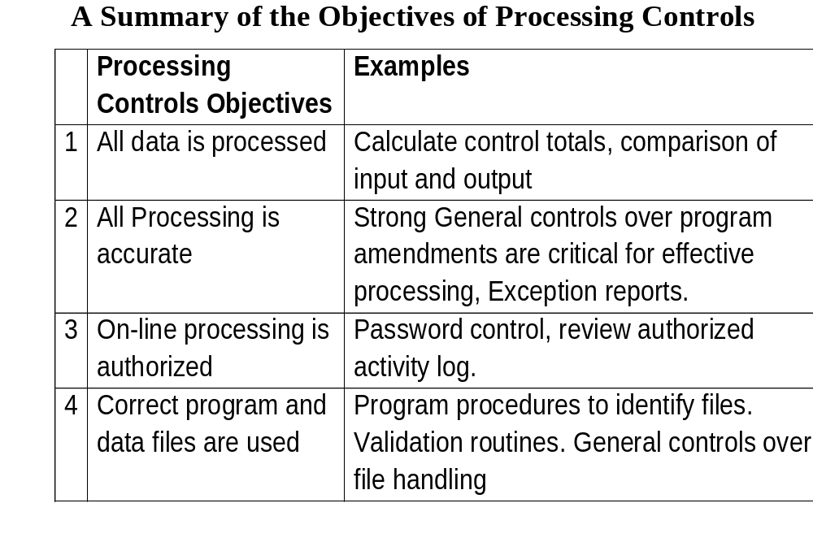
Mwamba Ally JIngu: FCPA; PhD

Slide 26
Key Questions – processing Controls
Are there controls to ensure that all data is processed Consider:
Use of control totals
User comparison of input and output
Are there controls to ensure that all processing is accurate? Consider:
Validation checks on results of processing.
Programmed checks on processing accuracy, such as summary processing
Controls over amendments to general program files (general controls)
Mwamba Ally JIngu: FCPA; PhD

Slide 27
Are there controls to ensure that all processing is authorized? Consider:
General operational controls
Special arrangements for controlling an ad hoc and online/real time processing
Use of activity logs
Are there controls to ensure that correct data and program files are used in processing? Consider
Programmed procedures for file identification
Validation checks on individual records
General controls over file handling
Mwamba Ally JIngu: FCPA; PhD

Slide 28
Output Control
Audit objectives
To ensure that all expected output is produced, that it is complete and appears reasonable, that it serves a useful purpose and is distributed on time, and in such a way that confidentiality is maintained as necessary.
The auditor needs to satisfy him/herself on the following:
Completeness of output
Reasonableness of output
Use of output
Timelines and confidentiality
Mwamba Ally JIngu: FCPA; PhD

Slide 29
Key Questions on Output controls
Are there controls to ensure that all expected output is produced? Consider
Controls over work flow in the Computer Centre
Do operations manuals include full listings of expected output?
User checks that all expected output is received
Is output distributed promptly and secured to authorized recipients only? Consider:
Controls over work flow in the Computer Centre
Output handling procedures.
What happens to output no longer needed?
Mwamba Ally JIngu: FCPA; PhD

Slide 30
Audit Around the Computer
Audit around the computer means that processing done by the computer system needs not to be audited as auditor expects that sufficient appropriate audit evidence can be obtained by reconciling inputs with outputs.
Evidence is drawn and conclusions are reached without considering how inputs are being processed to provide outputs..
However, former is widely understood meaning of the phrase. Now a days audit around the computer is considered as an auditing approach.
It is more often known as black box audit approach
Mwamba Ally JIngu: FCPA; PhD

Slide 31
Audit Around the Computer
Most often this approach is used either because:
processing done by the computer is too simple e.g. casting, sorting etc
auditor is already aware of the software’s reliability. This is the case with most of off-the-shelf software used by client without any in-house alteration and thus need not to be checked.
auditor has no mean to gain understanding of the computer system and thus resorts with this approach. This situation can arise out of circumstances including:
  lack of appropriate system documentation
  auditor lacks expertise or skills to understand or use the computer system for auditing purposes.
  auditor is not given access to computer system at the level required
Mwamba Ally JIngu: FCPA; PhD

Slide 32
Around the computer continued
Audit around the computer approach is used in situations when auditor is of the opinion that computer system is reliable and often comparison of inputs i.e. source documents to outputs i.e. financial reports is done which in auditor’s judgement is enough. .
Due to the same reason, relying too much on this approach is not recommended for important aspects of the audit especially where assessed risk is high as this may result in ineffective audit and ultimately inappropriate audit opinion being expressed by the auditor.
.
Mwamba Ally JIngu: FCPA; PhD

Slide 33
Interactive Questions
The following represent irregularities that could occur in a computerized environment. For each irregularity identify control procedures that would have been effective in either preventing or detecting the irregularity. (i.e., input; processing or output control)
(i) A deposit for Julius A. Kingu at the local bank was recorded as a deposit in the account of Juliet A. Jingu
(ii) Duplicate payments were prepared for all employees of the accounts section in Mangu & Co for the month ended December, 2015. This occurred because the data processing department processed the data payment vouchers twice
Mwamba Ally JIngu: FCPA; PhD

Slide 34
Interactive Questions continued
(iii) An individual in the accounts section gained access to the products master file and, in an attempt to change prices for one customer, inadvertently changed prices for the products identified for all customers
(iv) An employee in the sales department who was annoyed about inadequate pay raise copied the products master file and sold it to the competitor. The master file contained information on the cost and sales price of each product as well as special discounts given to customers
Mwamba Ally JIngu: FCPA; PhD

Slide 35
Iterative Questions Continued
(v) A customer order was filled and sent to a former customer, who had already declared bankruptcy
(vi) The selling price for all products handled by a company sales person was consistently reduces by 25% by a sales person. The sales manager did not authorize the sales person to reduce prices from a price list.
(vii) A customer number was transposed during the order-taking process. Consequently, the sales were billed to another person. By the time the original customer was identified, the original customer was out of business
Mwamba Ally JIngu: FCPA; PhD

Slide 36
(viii) The accounts receivable clerk, who also operated the company’s personal computer, took cash remittances and recorded the credit to the customer’s account as a discount.
(ix) A disgruntled programmer often came to the office in the evenings to copy confidential client data such as customer lists, discounts, and so forth on the magnetic tapes, which he sold to competitors at handsome prices.
(x) A computer programmer added a module to the payroll program that started with an “IF” statement to identify his employee number. If it were his record, the program was instructed to multiply computed pay by 1.5, thus increasing the programmer’s pay by 50%
Mwamba Ally JIngu: FCPA; PhD

Slide 37
Iterative Question Continued
(xi) The social services department made support payments to poor students. A poor student could be input into the system on recommendation of “warden or matrons”.
Some wardens and matrons entered fictitious students on the system and had support payments sent to authorized addresses.
The wardens and matrons then cashed the support payments and eventually transferred the cash to their own accounts
Mwamba Ally JIngu: FCPA; PhD

Slide 38
Thank You for Your Attention
Now it is a Discussion Time
Mwamba Ally JIngu: FCPA; PhD

